Slide 1

Flash Gas Estimation
Thomas Manuel Ortiz, Ph.D., P.E.
June 11, 2019

Slide 2

Tankless Oil Gathering Systems Will Soon Be Common
Lease Boundary
Measured Gas
Calculated Flash Gas
High Vapor Pressure Oil
Calculated Stable Oil
Measured Water

Slide 3
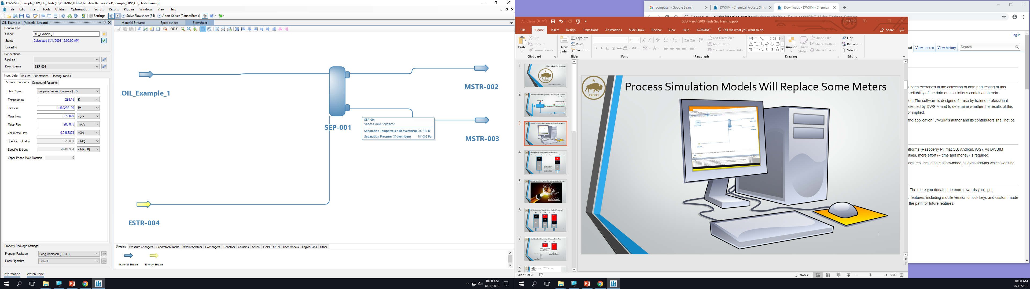
Process Simulation Models Will Replace Some Meters
Process simulation software can predict the separation of oil and gas using thermodynamic models called Equations of State (EOS)

Slide 4
Verifying EOS: Flash Liberation Testing in the Lab
Reservoir Pressure and Temperature
Separator Pressure and Temperature
Oil
Gas
Oil
Hg
Removing mercury from the test cell allows the pressure to drop and gas to evolve from the oil
Hg

Slide 5

The Importance of a Controlled Laboratory Environment
Flashing a liquid from high to low pressure will release a large amount of stored energy.
Image Source: [1]

Slide 6
Oil Continues to “Shrink” When Flashed Repeatedly
T1, P1
>
T2, P2
>
T3, P3
Oil
Gas
Gas
Oil
Oil
Hg
Hg
Hg

Slide 7
And Flash Gas Composition Changes Every Time
T2, P2
>
T3, P3
Gas
Gas
Lighter Hydrocarbons
Leaner Gas
Lower Heating Value
Oil
Heavier Hydrocarbons
Richer Gas
Higher Heating Value
Flashes First
C1
C2
C3
C4
C5
C6+
Flashes Last

Slide 8
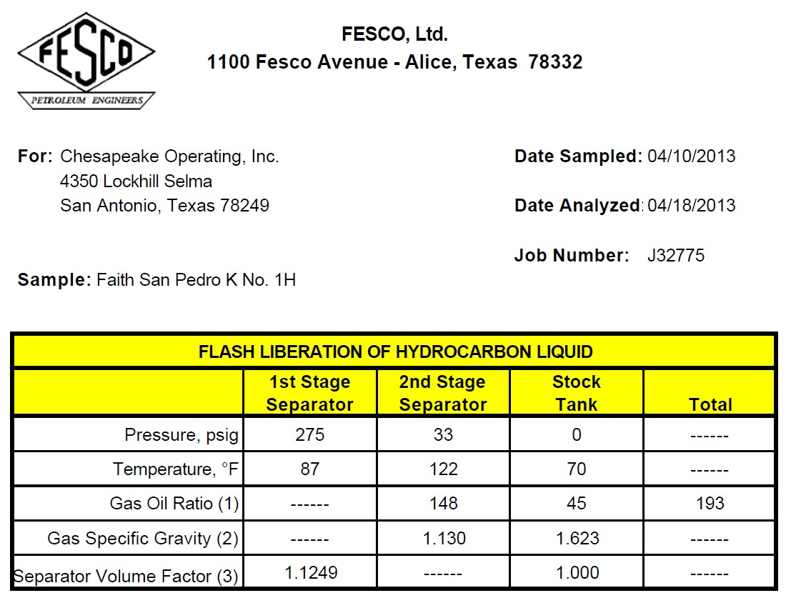
We Can See This By Reading Lab Reports
Heater Treater
Heavier Gas
Oil Shrinkage

Slide 9
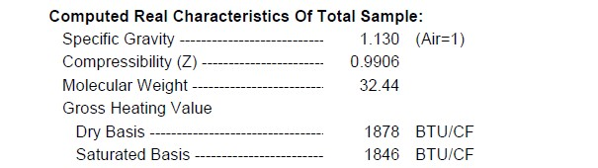
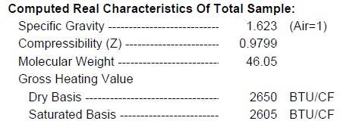
Reference Separation Stage by Specific Gravity

Slide 10
Flash Gas Calculation Using Gas Oil Ratio (GOR)
“Produced Gas”
Not Included Here. Includes free, or “casinghead” gas
for every 1000 STB of stock tank oil through a two-stage separator train having the GOR values shown
Stage 1 Flash Gas
GOR = 148 Scf/STB
Stage 2 Flash Gas
GOR = 45 Scf/STB
A well produces
1000 x (0.148 + 0.045)
= 193 Mscf
of flash gas (i.e. a total GOR = 193 SCF/STB)

Slide 11
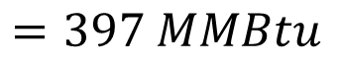
Flash Gas Energy Attributable to These Volumes
$$E_{flash gas}=1000 STB\left(1.878\frac{MMBtu}{Mscf}×0.148\frac{Mcf}{STB}+2.650\frac{MMBtu}{Mscf}×0.045\frac{Mcf}{STB}\right)$$
$$=397 MMBtu$$

Slide 12
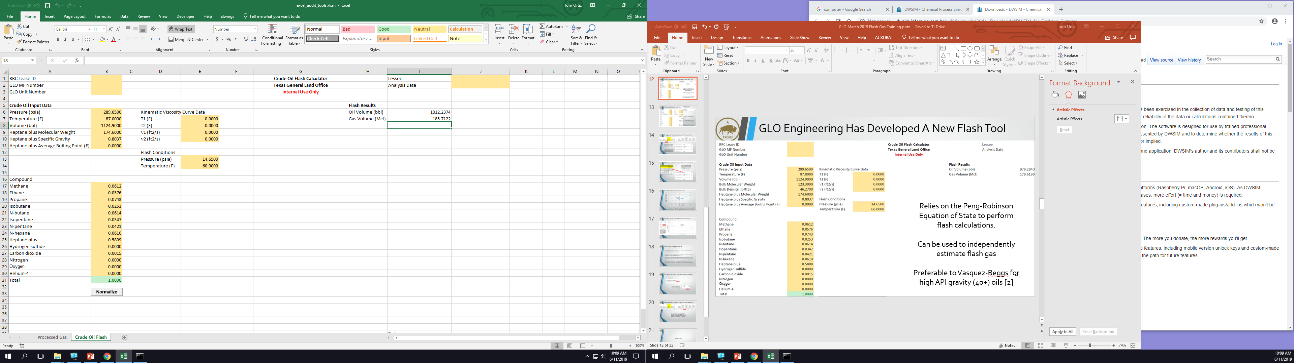
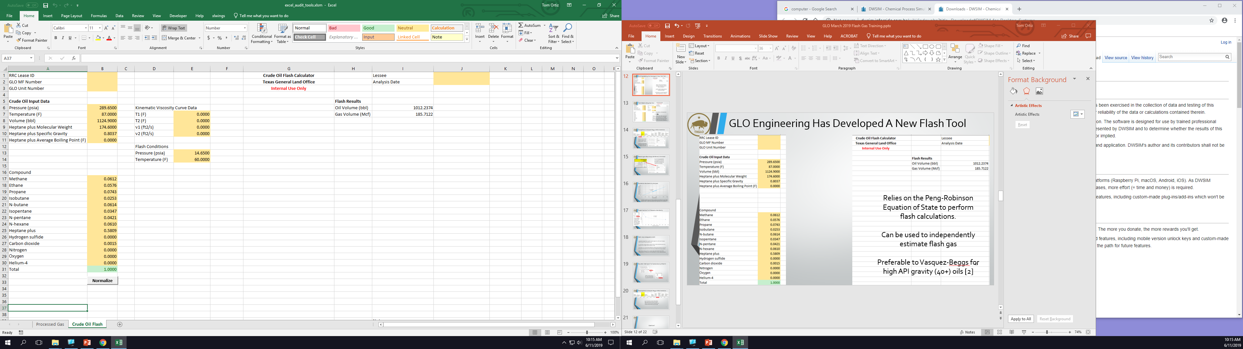
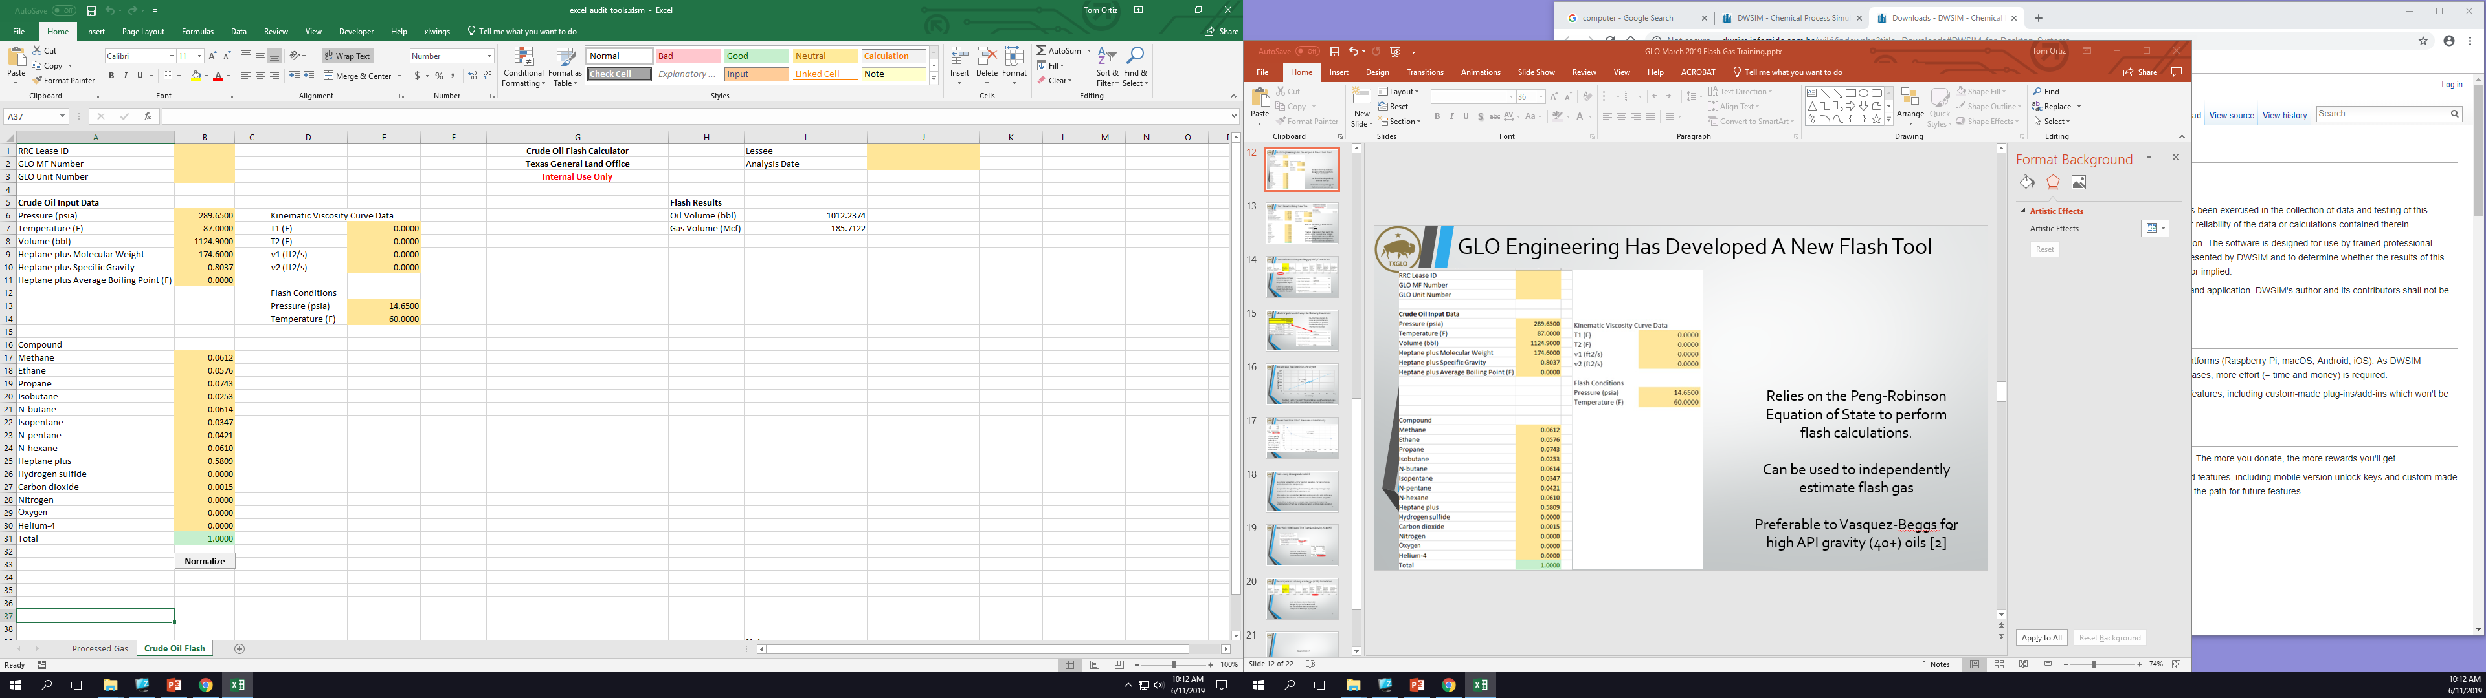
GLO Engineering Has Developed A New Flash Tool
Relies on the Peng-Robinson Equation of State to perform flash calculations.
Can be used to independently estimate flash gas
Preferable to Vasquez-Beggs for high API gravity (40+) oils [2]

Slide 13
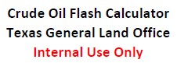
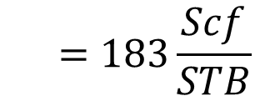
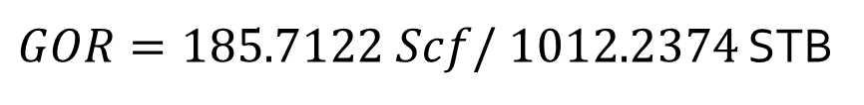
Flash Results Using New Tool
$GOR=185.7122 Scf/ 1012.2374$ STB
$$=183\frac{Scf}{STB}$$
The tool underpredicts flash gas by 5%, which is to be expected since multiple stages will increase the amount of flash gas. Multistage tool (in development) will result in more accurate calculations.

Slide 14
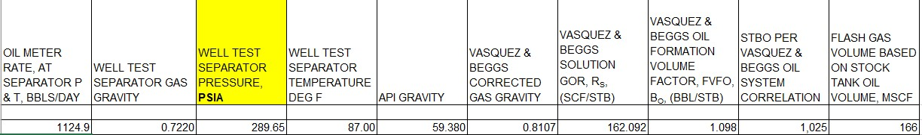
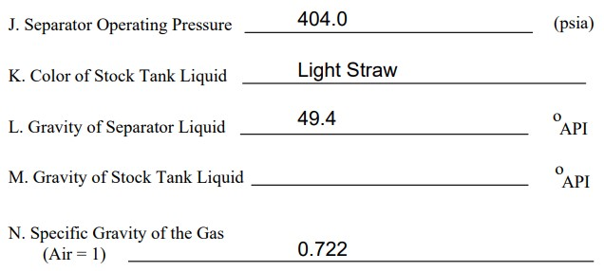
Comparison to Vasquez-Beggs (V&B) Correlation
Caveat: Actual 3 Phase Separator gas gravity not provided in report.
Is it OK to estimate gas gravity from RRC Form G-5 data for this well?

Slide 15
Model Inputs Must Always Be Mutually Consistent
No, it isn’t appropriate to use a gas gravity that was generated at 404 psia in a model that is being run at 289.65 psia (275 psig)

Slide 16
But We Can Run Sensitivity Analyses
To obtain a GOR of 193 SCF/STB using V&B, we would have to input a gas gravity of 0.86. Is that a reasonable value of gravity for our conditions?

Slide 17
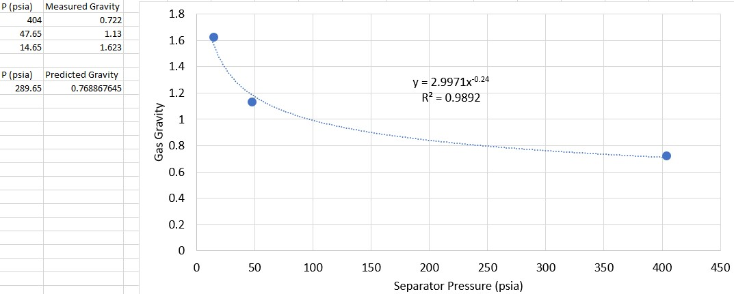
Power Function Fit of Pressure vs Gas Gravity
This is a purely mathematical, rather than a physical, model, but it does give us an indication of the trend.

Slide 18
V&B Likely Underpredicts GOR
Gas gravity ranges from 0.55 for very lean gases to 1.5 for very rich gases, with a “typical” value being 0.65. [3]
It is possible, though unlikely, that the initial, 3 Phase Separator gas at 275 psig was rich enough to have a gravity > 0.85.
This leads us to conclude that V&B likely underpredicts the GOR in this case, but we don’t know by how much unless we can obtain the true gas gravity.
Again, these results are from a single-stage model, which means that underprediction of flash gas is to be expected vis a vis two-stage separation

Slide 19
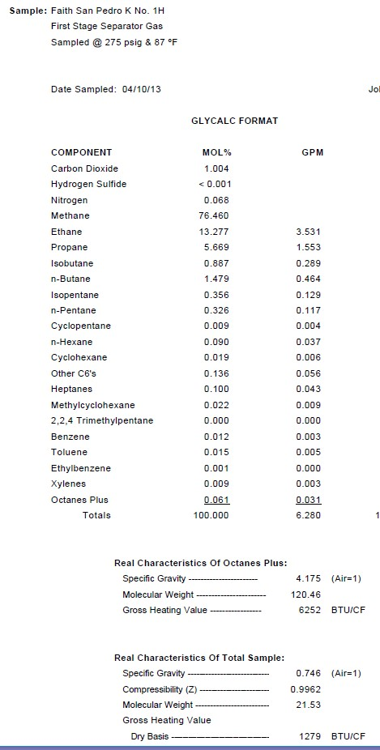
But, Wait! We Found The True Gas Gravity After All!
And it is quite close to the value predicted by our power function fit.

Slide 20
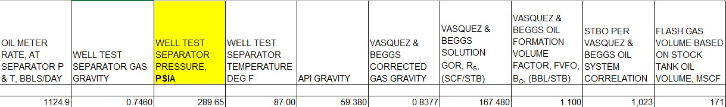
Recomparison to Vasquez-Beggs (V&B) Correlation
So, in conclusion, V&B underpredicts flash gas by 13% in this case. Recall that the new GLO flash calculation tool underpredicted flash gas by only 5%.

Slide 21
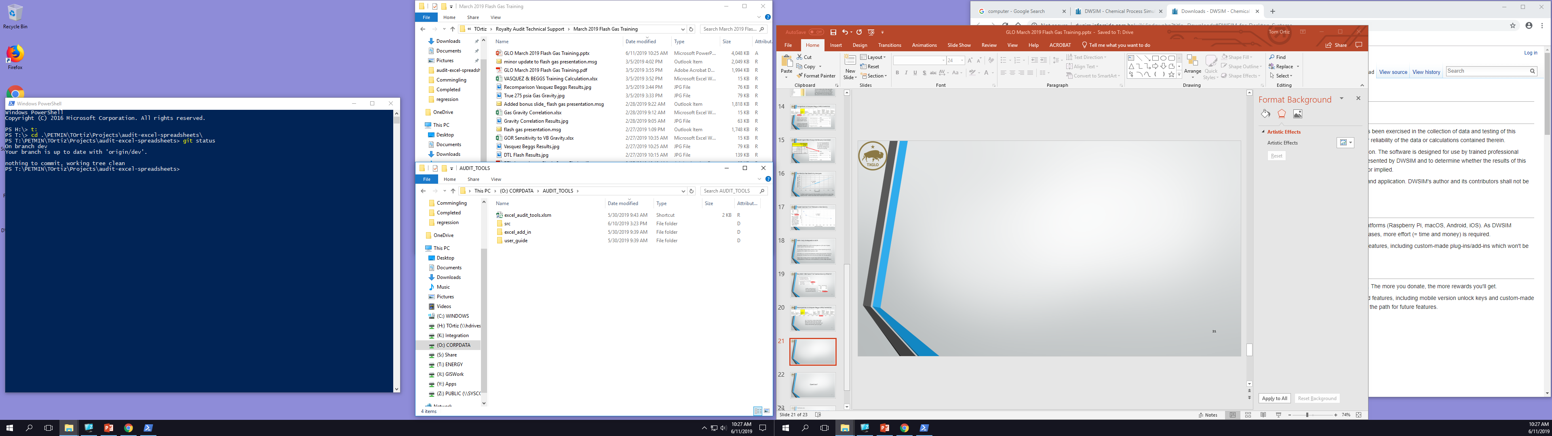
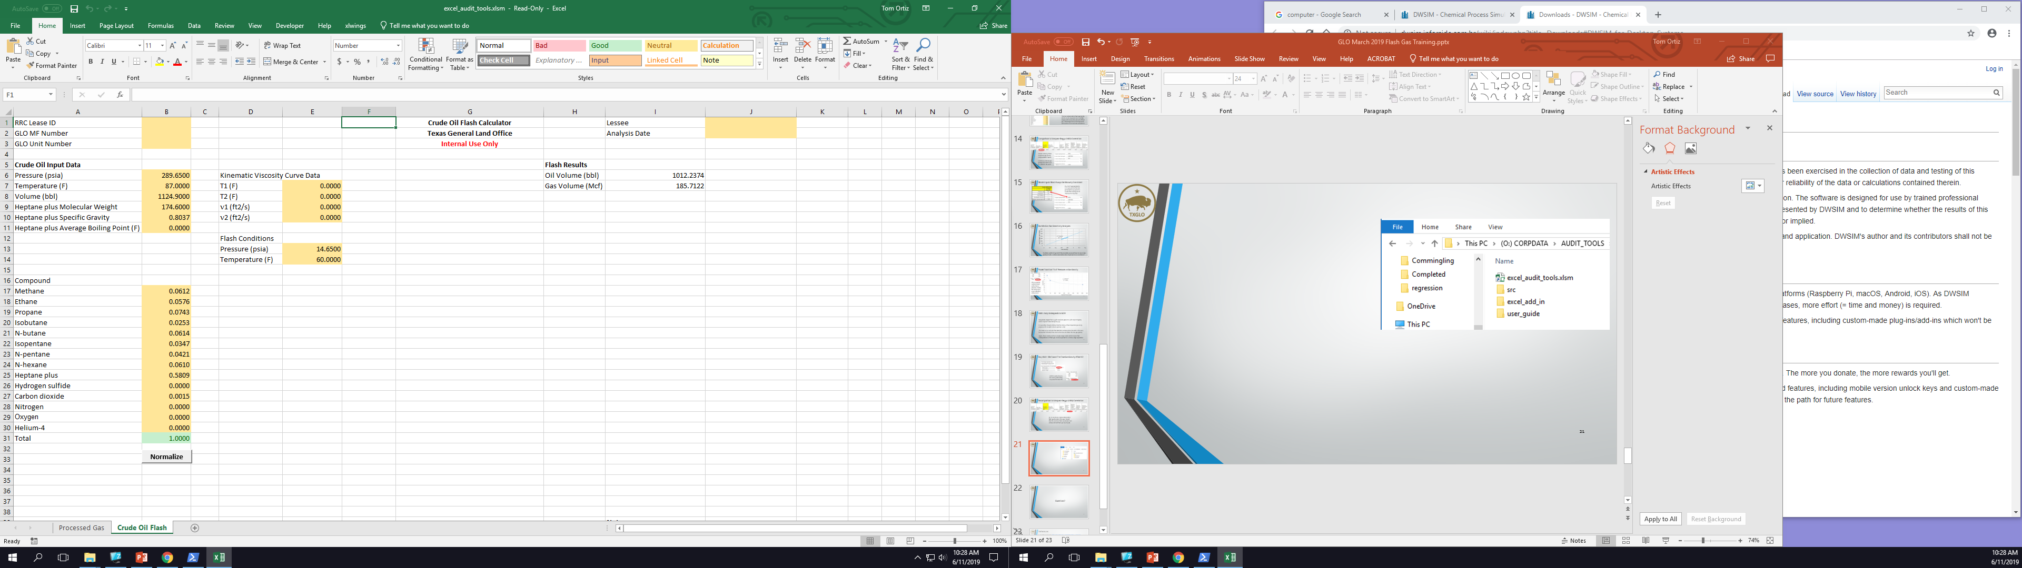
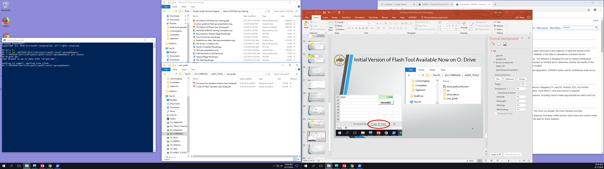
Initial Version of Flash Tool Available Now on O: Drive

Slide 22
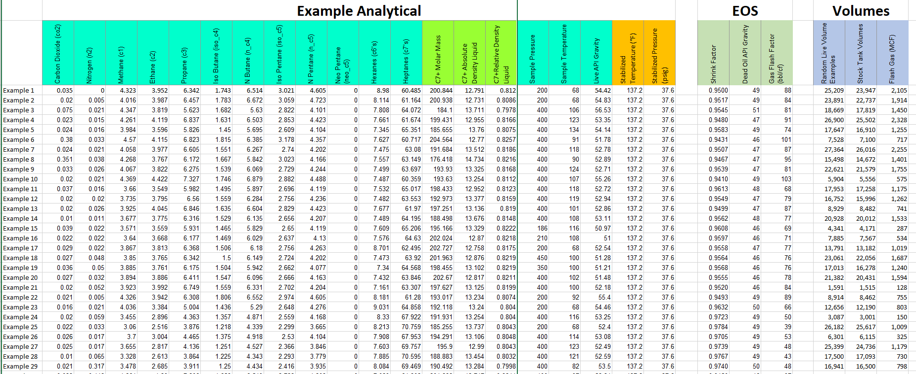
Try It Yourself Using Sample Data
Can you match the Volumes using the GLO tool? How close is “close enough”

Slide 23
Model Calibration Can Be Difficult
EOS models often must be calibrated, or “tuned” to the particular crude oil being flashed
Extensive tuning typically means that physical sample quality is poor
“PVT experiment” data is required for tuning
For instance, the differential liberation test data shown here
GLO Engineering will work with you to establish guidelines for reasonable uncertainty bounds

Slide 24
Future Work
Support up to four separation (flash) stages
Connect flash to Processed Gas tab
Automatically generate processed gas values
Create command line mode
Automatically run multiple inputs as batch job
Automate script data input from database
Check lease reporting values every month
Requires data submission from lessees

Slide 25
Questions?

Slide 26


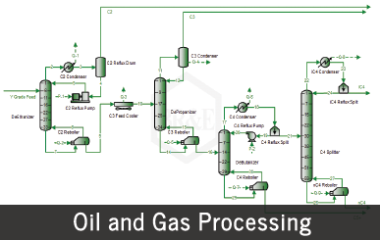
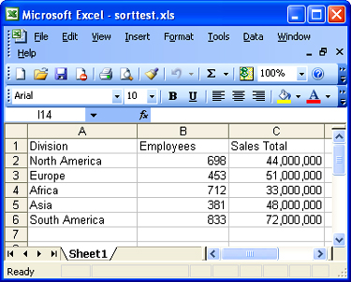
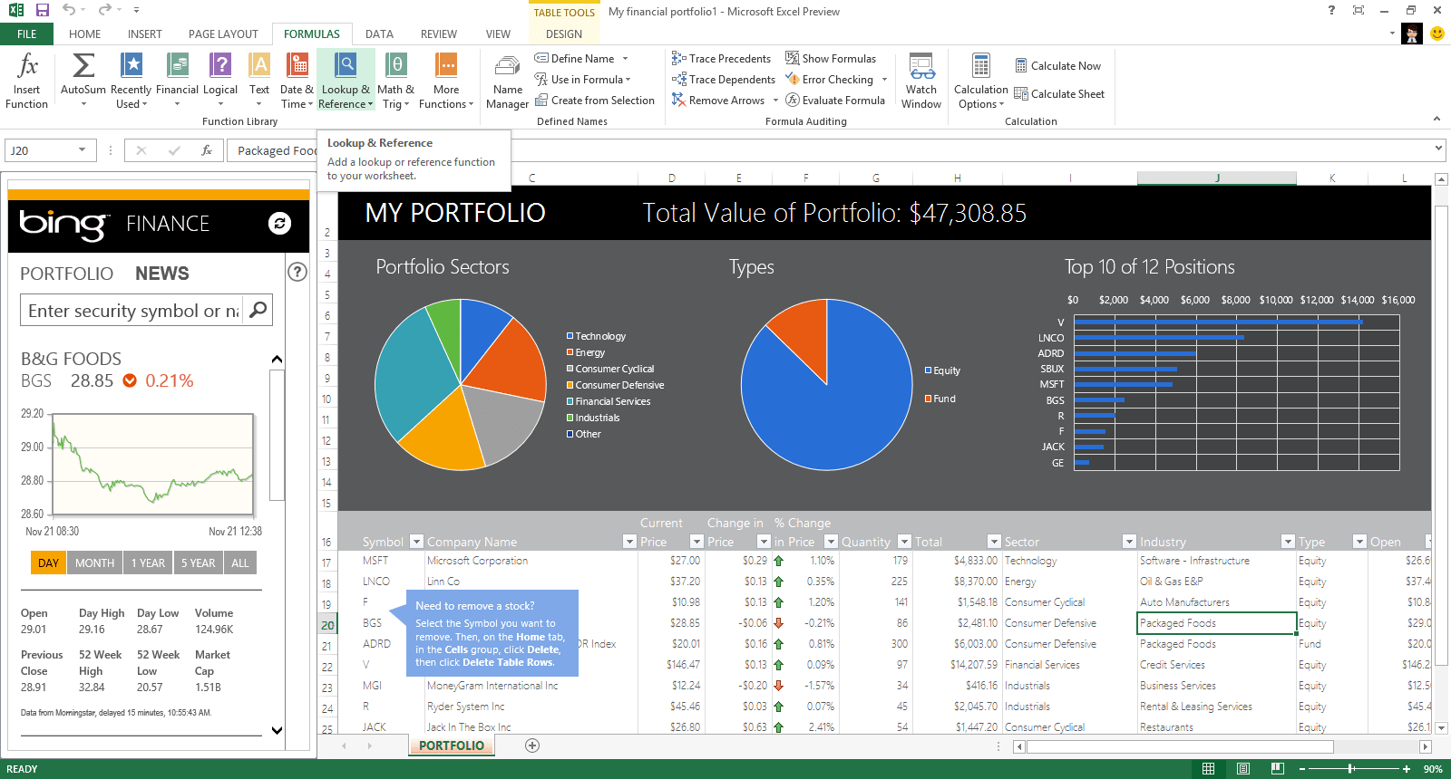


GLO Energy Resources relies on a library of spreadsheets for sharing engineering calculations with the Minerals Audit team
GLO Energy Engineering Calculation Engine Project
GLO Energy Resources engineers have ported the spreadsheet library to Python, whereupon engineering calculations will be maintained on and served from the GLO network with Excel-based output.
Single, verified source of calculations
Secure, transparent updates
Includes process simulation workflows
DWSIM
If the engineer and auditor aren’t talking about exactly the same calculations, then mistakes can occur.
xlwings

Slide 27
References
Desktop Computer, https://en.wikipedia.org/wiki/Desktop_computer
Champagne Opening, https://all-free-download.com/free-photos/download/champagne-opening-moments_165737.html
Texas Commission on Environmental Quality (2012), “Calculating Volatile Organic Compounds (VOC) Flash Emissions from Crude Oil and Condensate Tanks at Oil and Gas Production Sites”, Air Permit Reference Guide APDG 5942, https://www.tceq.texas.gov/assets/public/permitting/air/Guidance/NewSourceReview/guidance_flashemission.pdf , p. 15
Fekete Associates, “Gas Gravity”, http://fekete.com/SAN/TheoryAndEquations/WellTestTheoryEquations/Gas_Gravity.htm

